Slide 1
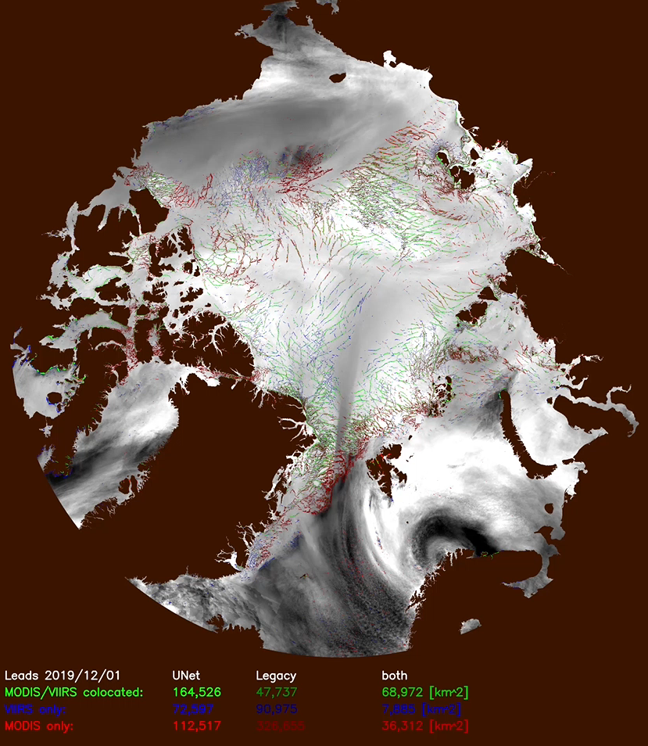
Satellite Detection of Sea Ice Leads Using Machine Learning
Project Team
PI: Jay Hoffman (CIMSS)
Unfunded Collaborators: AI-coders group, Yinghui Liu (STAR), Jeff Key (STAR)
Summary
Develop a machine learning based sea ice lead (fracture) detection technique to improve upon the legacy algorithm.
Current status
Validation data
  Hand analysis of BT imagery
  Hand analysis of detection masks
Iterative process, training & running model
Initial results are encouraging
  Results from entire month of December 2019
  Improvement over legacy algorithm
    More true positives
    Fewer false positives
    Better agreement between VIIRS & MODIS
Goals
Highlighting the initial results, prepare NASA ROSES proposal to replace legacy leads product
Explore using additional datasets (started looking at VIIRS DNB)
Optimize code to run on high capacity computer systems (to be able to process historical data)

